Slide 1



INSTAGRAM INFLUENCER INSIGHTS

Slide 2
DATA OVERVIEW
Source: Instagram Influencer Database (Kaggle)
Size: 200 records × 10 features
Key Features: Influencer Name, Followers, Engagement Rate, Country, Influence Score
Data Types: Combination of numerical, categorical and text

Slide 3
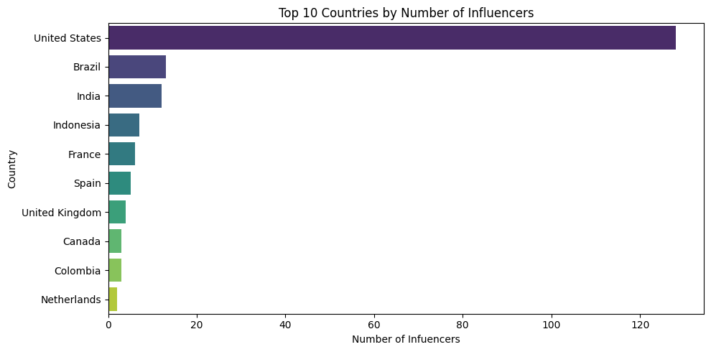
The United States has far larger number of influencers.
Brazil and India follow at distant second and third.
The remaining countries like Indonesia, France, and Spain show comparatively modest count.
Top 10 Countries by Number of Influencers

Slide 4
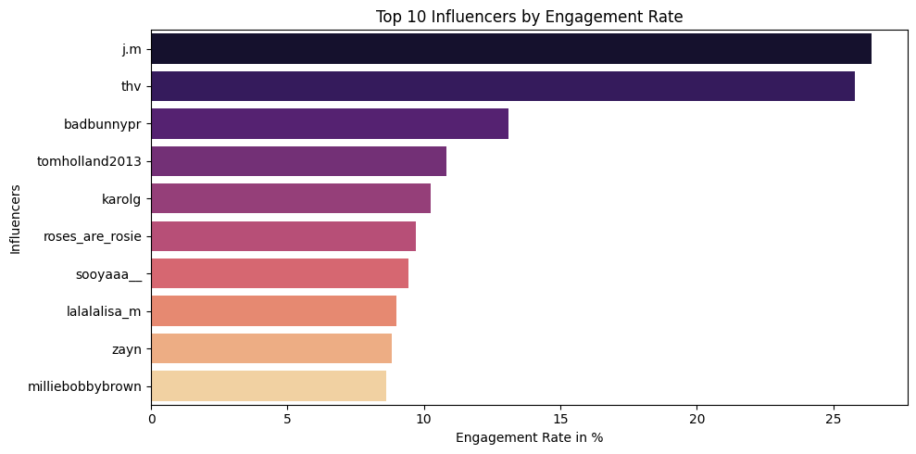
Top 10 Influencers by Engagement Rate
j.m and thv are the top two influencers with the highest engagement rates, both over 25%
milliebobbybrown has the lowest engagement rate among the ten, at just under 10%

Slide 5
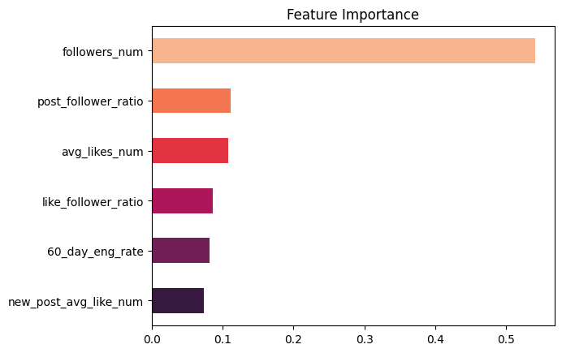
Feature Importance
followers_num is by far the most important feature, with an importance value of over 0.5
post_follower_ratio and avg_likes_num are the next most important features, with values around 0.1
The remaining features are the least important

Slide 6
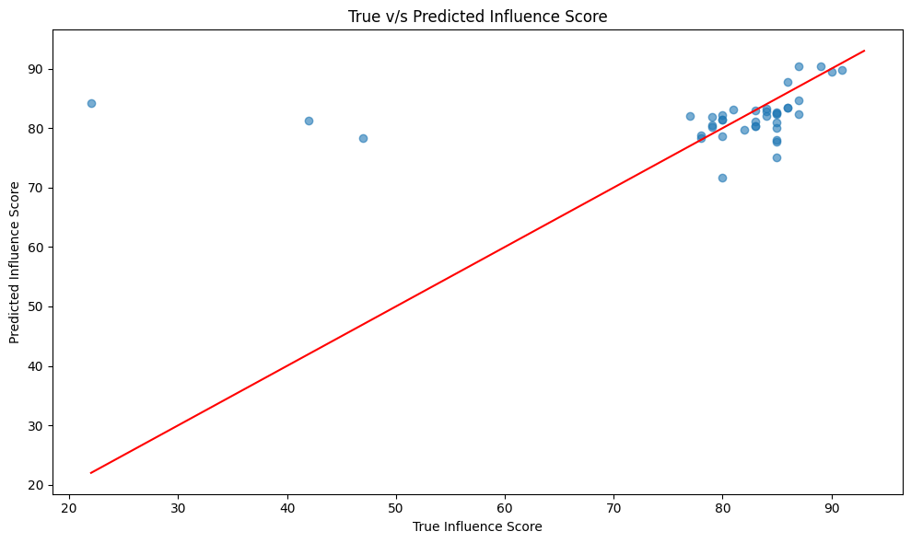
Model Prediction Performance: Influence Score
Most predictions are clustered around the high true scores
(around 80-90)
A few points with low true scores (20–50) are predicted with much higher influence scores (80–90) indicating significant overprediction for those cases
the model is doing reasonably well, though there are some notable outliers.

Slide 7

United States hosts the largest pool of influencers, making it the prime market for
wide-reach campaigns.
Brazil and India emerge as valuable secondary markets, combining growing audiences with promising engagement potential.

Slide 8
BUSINESS INSIGHTS
U.S. offers the widest influencer reach, ideal for large-scale brand visibility.
Partnering with high-engagement creators (e.g., j.m, thv) can drive strong
Return on Investment (ROI) regardless of follower count.
Brazil and India present growing, cost-effective markets for regional expansion.

Slide 9
Presented by Ayesha Nadaf
Thank you!

